Slide 1


One Touch Build & Deployment Automation

Slide 2
Build & Deployment(BD) Approach
Automation build for BD* as follows
All BD is based on environment(Dev/Test/…./n) for a release
All configuration required for BD should be upload the BB as defined structure
Using BD, we do the following activities
Deploy only WL resources(property files) to a specific env. from BB
Checkout and build the services to a specific env. from BB
Upload the build jar into bitbucket with built number for a specific env.
Deploy only the built jar from BB to a specific env. with given built number
Full deployment for a specific env. for a release
i.e., checkout all required WL resources, OSB customization, service resources & env. details
Build service jars
Deploy required WL resources, built jars and apply the OSB customization.
Apply only OSB customization
*BD – Build and Deployment

Slide 3
Bitbucket Structure for BD*Automation
Integrationrelease
Nexus Build repository
Dev
Test
PreProd
Prod
Env. n
OSB customization
WLS Resources
Service Resources
Env. Details
Test Scripts**
Builds
Master
Release
Master
Release
Master
Release
Master
Release
Dev
Test
*BD – Build and Deployment
** Test scripts – it’s place holder for next release

Slide 4
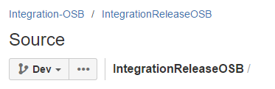
IntegrationReleaseOSB
Dev
Test
PreProd
Prod
Env. n
Codebase
ServicesConfig
Service1
Service2
Service n
Service1
Service2
Service n
Service config files
Dependencies
Service dependencies
Dep_<ServiceName>.json
WLS dependencies
WLS property files for a service
aq_details.property
db_details.property
fsjms.property
jms.property
Customization
Customization file

Slide 5
Jenkin Jobs
WL Resources deployment
Service Resources checkout and Build
Services deployment from built Jar
Full Services deployment (WL Resources, check out, build & deployment)
Apply OSB customization

Slide 6
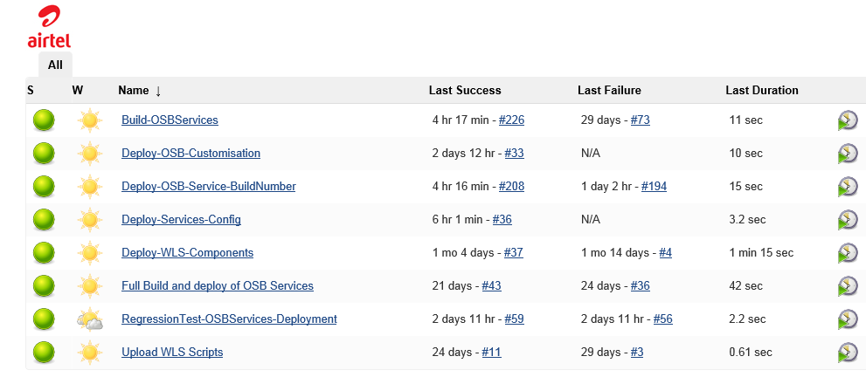
Jenkin Jobs Screen shot
http://10.5.194.245:8080/

Slide 7
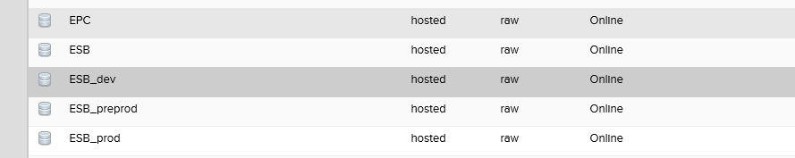
Nexus Build repository
http://10.5.194.176:8081/

Slide 8
Jenkins Build Logs

Slide 9
WL Resources deployment
Run the Jenkin job for given env.(Dev/Test/PP/Prod/…./n)
Scripts will checkout the WL resources and Env. details from BB for a requested env.
Scripts will connect to the requested Env.
WL resources will be deployed into requested Env.

Slide 10
Service Resources checkout and Build
Run the Jenkin job for given env.(Dev/Test/PP/Prod/…./n)
Scripts will checkout the service resources from BB for a requested env.
Build the jar from check out service resources
Connect to BB and upload the build with build number

Slide 11
Services deployment from built Jar
Run the Jenkin job for given env.(Dev/Test/PP/Prod/…./n) and built Number
Scripts will checkout the Build jar and OSB customization from BB
Scripts will connect to the requested Env.
Built jar will be deployed into requested Env.
Apply the OSB customization on top of jar deployment.

Slide 12
Full Services deployment
Run the Jenkin job for given env.(Dev/Test/PP/Prod/…./n)
Scripts will checkout the WL resources, OSB customization, service resources and Env. details from BB for a requested env.
Scripts will checkout the Build jar from BB
Scripts will connect to the requested Env.
Deployment as below
WL resources
Build jar
Apply the OSB customization

Slide 13
Apply OSB customization
Run the Jenkin job for given env.(Dev/Test/PP/Prod/…./n)
Scripts will checkout OSB customization from BB
Scripts will connect to the requested Env.
Apply the OSB customization

Slide 14


